Slide 1
Walk Two Moons
Cooperative Learning

Slide 2
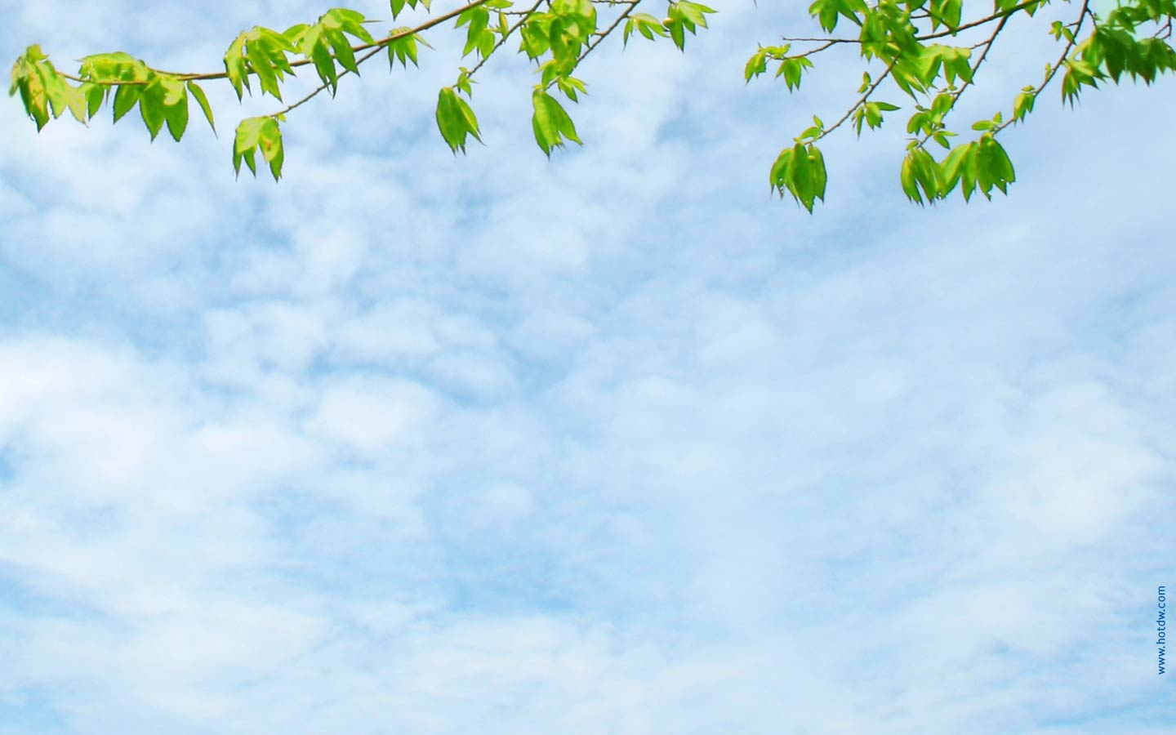
Travel Brochure
The teacher will bring in sample travel brochures, both physical and digital.
In their groups, the students will choose a location visited in the novel.
As a class, we will go to the computer lab. The groups will have the entire class to complete their brochure using their chosen medium (Publisher, Prezi, Word, etc).
When we arrive at each destination in the book, the groups will share their brochures. The class will gain better awareness of the sites visited.

Slide 3
The Good Man
After reading Chapter 18, “The Good Man,” the class will respond to the following questions: What details from the chapter provide the best proof that Sal’s father is a good person? Why?
In their groups, students will write words or phrases on a large piece of paper that describe a good person.
The groups will tape their paper to the wall.
The groups will move clockwise around the room, looking at the other groups’ papers, and adding any characteristics that they had that the other group has not identified.
The students will reconvene with their original group and assimilate all their characteristics into a short paragraph describing a good person.

Slide 4
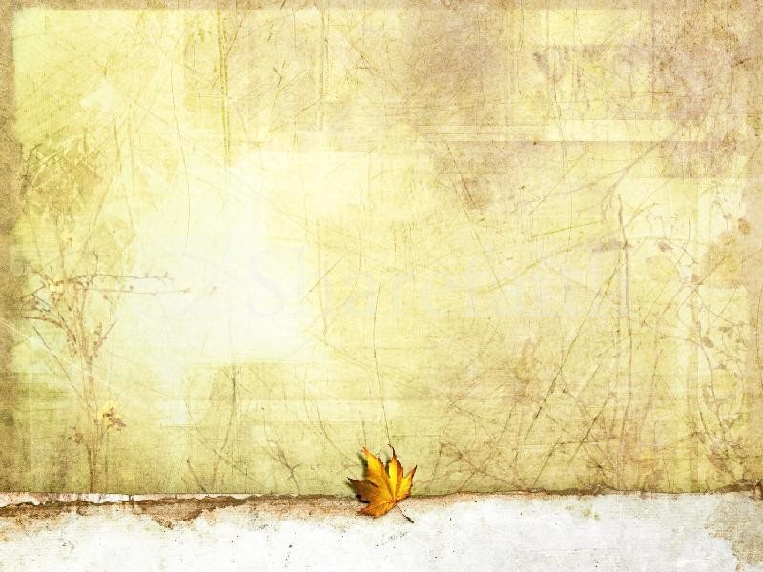
Soul Drawings
In the book, the students in Sal's class are asked to draw their souls. The results are profound and say a lot about the students.
After the students have read this scene (p. 129), they will be asked to draw their own souls.
They should keep their soul secret.
Like the book, the class will display their “souls” without names and attempt to find out which picture belongs to which person.

Slide 5
Tear and Assemble Mural
The students will be divided into five groups and given the task of interpreting the mysterious messages left for the Winterbottoms.
Don't judge a man until you've walked two moons in his moccasins.
Everyone has his own agenda.
In the course of a lifetime, what does it matter?
You can't keep the birds of sadness from flying over your head, but you can keep them from nesting in your hair.
We never know the worth of water until the well is dry.
After brainstorming, the students will be told that they will be making a mural that will convey the meaning of the message using pictures or symbols.
However, this mural will involve A LOT of cooperation.

Slide 6
Tear and Assemble Mural Cont.
Each group will be given a large piece of paper with the quote written on the top.
Each group member will be given a different color paper. They may only use this color.
The group as a whole will be given several glue sticks.
Working as a group, the students will tear their individual colors and contribute to their mural. They must communicate with each other in order to create a cohesive product.

Slide 7
Summary Skit
Upon completion of the novel, each group will be assigned a few chapters from the book to summarize.
Working together, they will write a short (2-3 minutes) skit highlighting the main events from these chapters.
Each group will present their skit to the class.

