Slide 1
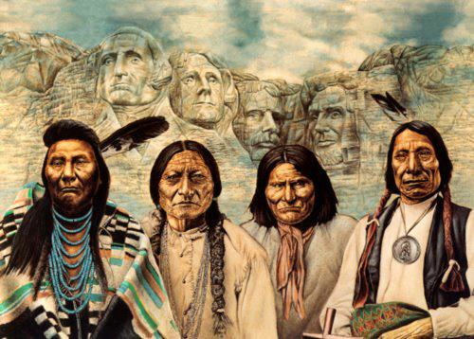
Walk Two Moons
Perspective

Slide 2
Perspective
When Sal visits Mount Rushmore in Walk Two Moons, she thinks about the local Indians’ perspective: “I’ve got nothing against the presidents, but you’d think the Sioux would be mighty sad to have those white faces carved into their sacred hill” (p. 179).
Students will research the history of Mount Rushmore and the Crazy Horse Memorial and present the points of view of the different groups who are connected to the land.

Slide 3
Possible Guiding Questions
Who originally lived on the lands occupied by Mt. Rushmore?
What happened to them?
Who are the presidents portrayed on Mt. Rushmore?
What were the policies of these presidents towards Native Americans?

Slide 4
Possible Guiding Questions
Why was Mt. Rushmore carved? What does it represent?
What did it take to make Mt. Rushmore a reality?
Why was the Crazy Horse Memorial started? What does it represent?
Do Native Americans want the Crazy Horse Memorial?
Why isn’t the Crazy Horse Memorial completed?

Slide 5
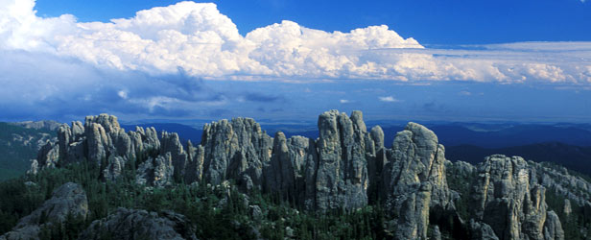
Investigate
Students will look at the resources provided on the teacher website, links and videos.
Students will be assigned a group associated with the Black Hills to continue their research.
Students will present the perspective of their group to the class.

Slide 6
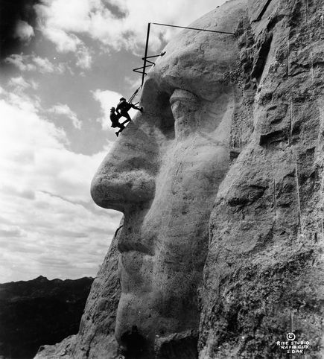
Perspectives
Native American tribes living on the land in the 1800s
Rushmore Creators – The Borglums
Rushmore Laborers
Crazy Horse Sculptor
Crazy Horse’s Descendants
Tourist

Slide 7
Personal Perspective
After the class has presented and discussed the different perspectives, they will develop their own perspective in the form of a thesis statement.
The students will write a five paragraph essay supporting their view point.

